Slide 1

PPT includes CDA features, Medical FSA, DCA, HSA, Limited Purpose FSA, and Commuter
>>CUSTOMIZE FSA Plan<< medical enrollment max, carryover, runout, and grace period information regarding Consolidated Appropriations Act, 2021
>>REMOVE THE SERVICES NOT OFFERED <<
Click the four squares in the bottom right corner to view all slides, delete as needed.

Slide 2
Consumer Driven Accounts (CDA)
Benefit Account Enrollment
BASIC | www.basiconline.com

Slide 3
BASIC CDA
Features

Slide 4
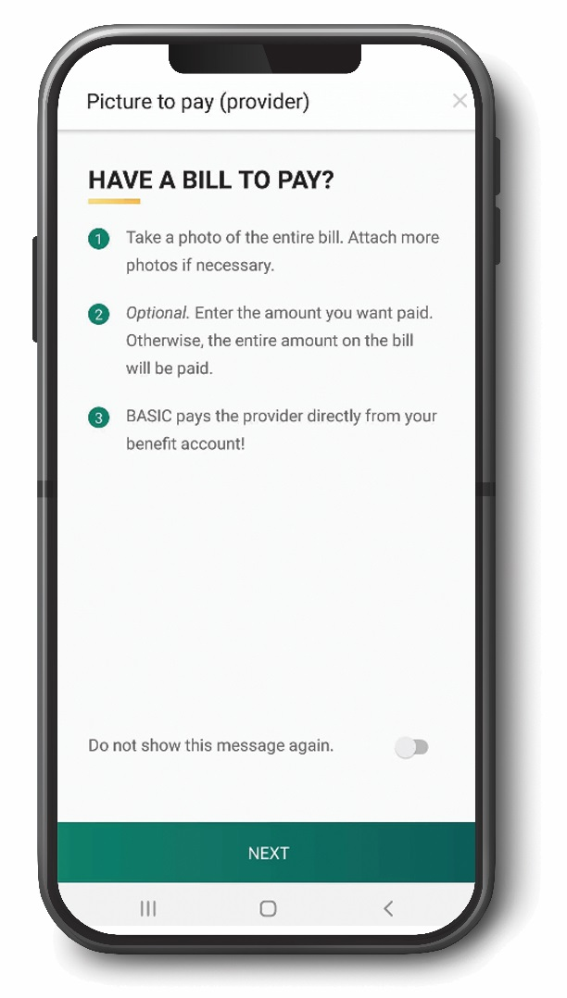
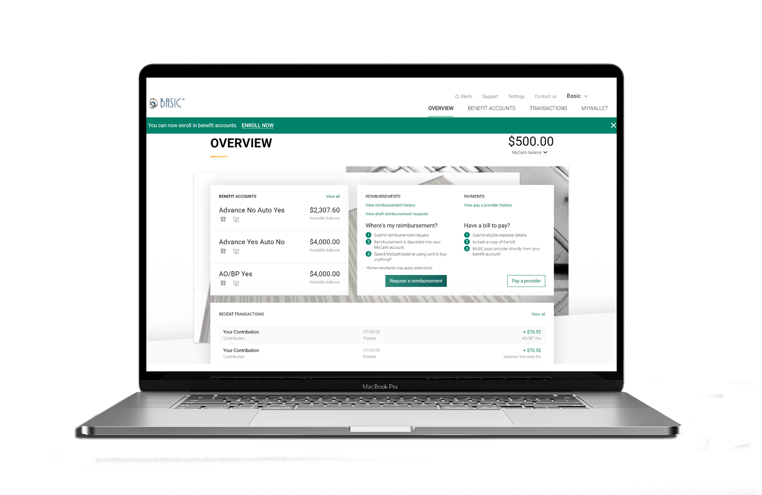
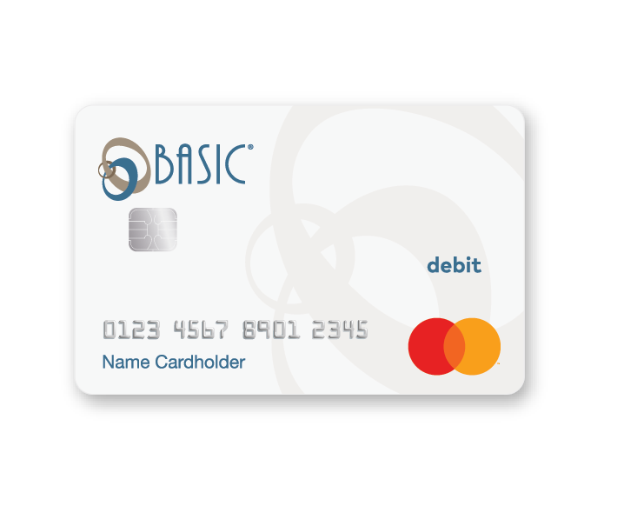
How to Access Your FSA Money

Slide 5
BASIC Card
Smart benefits card with access to all participant benefit accounts and MyCash
Eliminates the need for reimbursement requests
Proprietary technology instantly withdraws funds from the appropriate account(s)

Slide 6
BASIC Card
A Mastercard card will be issued upon enrollment
The BASIC Card comes loaded with the full Medical FSA election, and the up-to-date Dependent Care payroll deductions
Use anywhere Mastercard is accepted

Slide 7
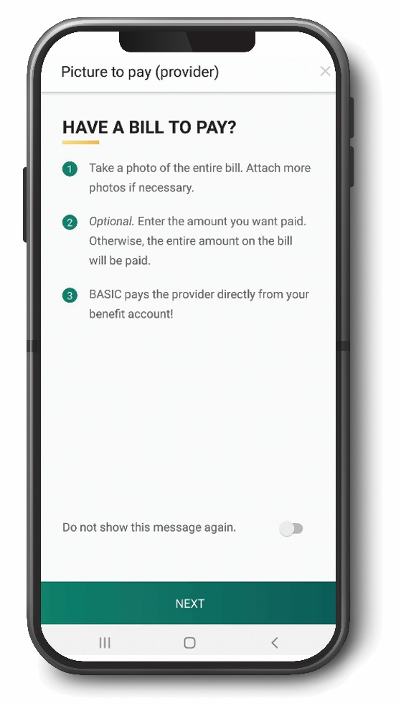
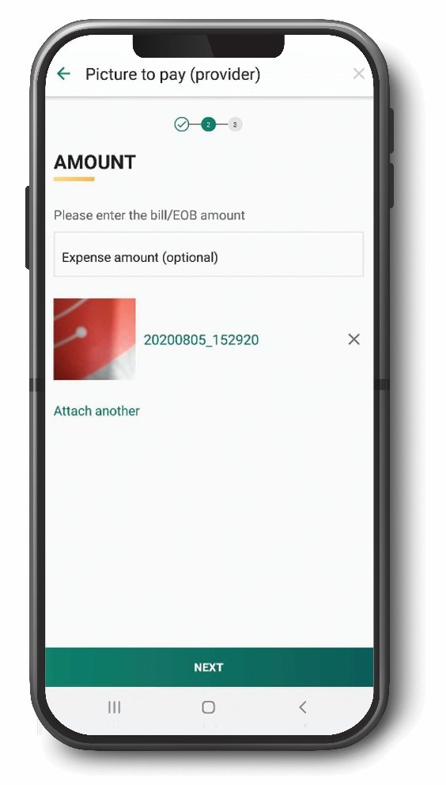
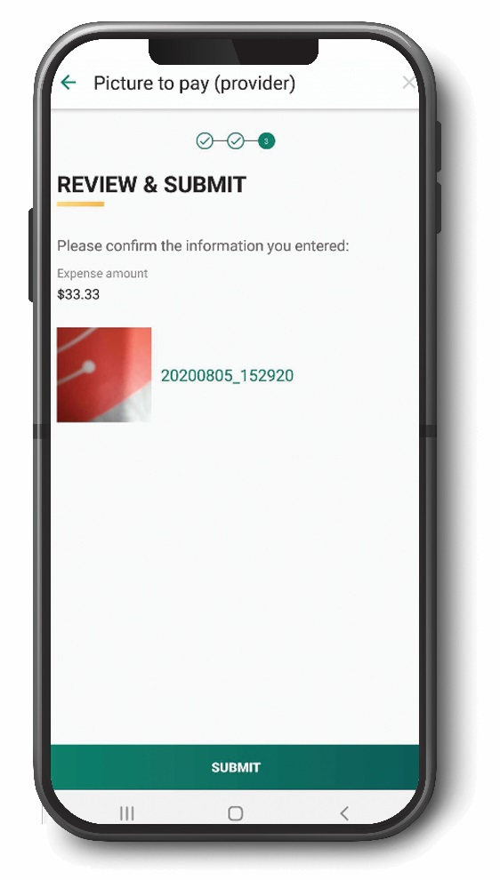
Picture to Pay
Take a picture of an eligible benefit expense/bill, then submit via the BASIC Benefits App
No forms to fill out and no need to sign-in to a website
Just click and submit and we’ll take care of the rest

Slide 8

Manual Reimbursement
Pay the provider out-of-pocket
Submit a claim to BASIC
  BASIC Benefits App submission – Take a photo of your receipt/documentation and upload
  BASIC Consumer Driven Accounts System (cda.basiconline.com) – Upload a scan or photo of your receipt/documentation
A tax-free payment will be deposited into your MyCash Account
  Faster than the speed of bank direct deposit

Slide 9

MyCash
MyCash is an unrestricted post-tax reimbursement account linked to participants’ BASIC Cards.
Reimbursements deposited directly into participants’ MyCash accounts – faster than check or direct deposit!
  Pay for non benefit eligible expenses from the MyCash account by using the BASIC Card anywhere Mastercard is accepted
  Transfer MyCash funds to personal savings or checking account via one-time or recurring transfer
  Withdraw MyCash funds at an ATM

Slide 10
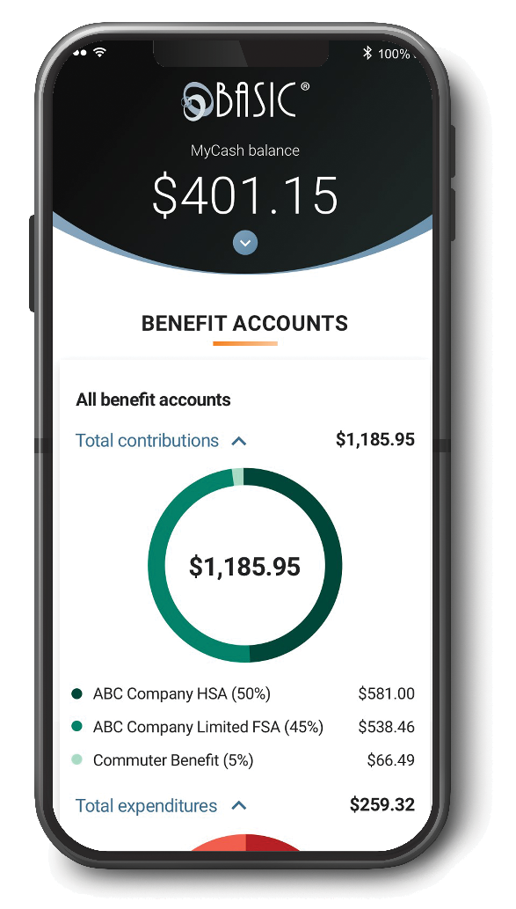


BASIC Benefits App
Participants can track and manage all their BASIC benefit accounts with a
single app – anywhere, anytime!
Access account information
Request reimbursement
Expense eligibility check
Mobile card lock if BASIC card is lost or stolen

Slide 11

Important Card Information
We have a 93% auto substantiation rate for debit card purchases
In some instances, participants will need to submit itemized documentation of their BASIC Card purchases
In all cases, itemized documentation for
transactions should be kept

Slide 12
Medical
Flexible Spending Accounts

Slide 13
What Is an FSA?
A Flexible Spending Arrangement (FSA) is a benefit program that reimburses specified, incurred expenses with pre-tax dollars
  Medical FSAs are governed under §125 of the Code
  Dependent Care FSAs are governed under §129 of the Code
Employee contributions to FSAs must be made through a Section 125 cafeteria plan through their employer

Slide 14
How Does It Work?
Held in an
account for
you
Returned to
you tax-free
for qualified
expenses
Pre-tax Paycheck
Dollars
Employees elect a set amount for medical expenses and a separate amount for dependent care expenses.
Every dollar you put in your FSA plan is Tax Free
You do not pay:
  Federal Taxes
  State Taxes
  (and local taxes if applicable)
  Social Security and Medicare Taxes

Slide 15
How Much Can I Save?
Out-of-Pocket Expenses | Annual Average | Taxes Saved (27% Tax Bracket)
Physician | $940 | $254
Co-Pay | $470 | $127
RX | $660 | $178
Outpatient Hospital | $430 | $116
Medical Total: | $2500 | $675
Dependent Care: | $5000 | $1350
Grand Total: | $7500 | $2025
You could save up to $2,025 per year or more.*
*Depends on Tax Bracket

Slide 16
Eligibility
Employees do not need to be on the employer’s health plan in order to participate in FSA plans
Medical expenses can be incurred by the employee, spouse, employee’s children, who have not attained age 27 as of the end of the taxable year, or the employee’s other “tax dependents”
Expenses must be incurred after the employee was a medical FSA participant
Expenses must be incurred during the plan year

Slide 17
Your FSA Plan
Plan year: XXXXXXX
Maximum medical election: XXXXXXXX
Use-it-or-lose-it: Unused contributions remaining at the end of the year will be forfeited by the participant

Slide 18
Your FSA Plan - continued
Medical
  Grace Period - up to two and one-half months after the end of the plan year to use funds in an FSA. Claims may be submitted for expenses incurred during the plan year and during the grace period. Grace periods are permissible for all types of FSAs.
  Carryover - allows participants to roll over $550 from one plan year to the next. The $550 is not calculated into the IRS maximum contribution.
  Run Out Period - is the time available following the end of the plan year in which people can submit expense. Can be added to the above options.

Slide 19
Consolidated Appropriations Act, 2021
Permits any amount of unused contributions from plan years ending in 2020 and/or 2021 to be carried over into the next plan year.
  Note: The carryover amount will not be subject to the annual IRS contribution limit for that plan year, even if the combined total with plan election exceeds the limit.
The grace period for participants to request reimbursements from their remaining balances has been extended for up to 12 months after plan year-end for plans ending in 2020 and/or 2021.

Slide 20
Consolidated Appropriations Act, 2021
Employees who cease their participation in their medical FSA during calendar years 2020 or 2021 may still incur expenses and receive reimbursements from unused contributions through the end of the plan year in which participation ceased (including any grace period, if applicable, and taking into account any extension of that grace period).

Slide 21

What Do I Need to Know?
Medical FSA
  You must sign up at open enrollment
  You can only change your election in the event of a qualified status change (e.g., marriage, divorce, birth, adoption, or death)
  Full annual election is available day one
Dependent Care FSA
  You must sign up at open enrollment
  You can change your election if your cost or care changes
  Pay-as-you-go account

Slide 22
Medical FSA Eligible Expenses
Medical, dental and vision co-pays, deductibles, and coinsurance
Prescriptions (including mail order)
Eyeglasses, Lasik, and contact lenses
Dental expenses including orthodontia
Nursing care and physical therapy
Smoking cessation programs and nicotine patches/gum
Diabetic supplies
Physical impairments
Hearing exam, hearing aids, and special batteries
Expanded eligibility list can be found here:
https://www.basiconline.com/wp-content/uploads/2016/10/Flex-Eligible-List.pdf

Slide 23

FSAs Are More Flexible!
Over-the-counter (OTC) medications and menstrual products are now FSA-eligible with the enactment of the CARES Act in 2020
OTC medicine such as pain relief, allergy pills, cough, cold, flu, and stomach remedies
Menstrual products including tampons, pads, liners, sponges, and cups

Slide 24
Dependent care
Flexible Spending Accounts

Slide 25
Dependent Care Eligible Expenses
Employee and spouse, if any, must be working, looking for work, or a full-time student
Expenses for care of qualifying dependents (i.e., the primary purpose is to ensure the individual’s well-being and protection)
Qualifying dependents are:
  A dependent child who has not attained the age of 13; or
  A spouse or other dependent who is physically or mentally incapable of caring for himself/herself and who has the same principal residence as the participant for more than half the year
Expanded eligibility list can be found here:
https://www.basiconline.com/wp-content/uploads/2020/04/BASIC-Dependent-Care-FSA.pdf

Slide 26
What is Documentation?
Explanation of Benefits (EOBs) are the best form of documentation
  If you don’t receive paper copies in the mail, you can most likely download EOBs from your medical carrier’s website
Receipts must show:
  Date of service (not payment date)
  Type and nature of service
  Who provided the service
  Cost of service
  Patient name
BASIC cannot accept canceled checks, credit card receipts, or balance forward/balance due invoices.

Slide 27
Your Dependent FSA Plan
Plan year: XXXXXXX
Maximum dependent care election: $5,000 if married and filing a joint return, or if the participant is filing single and $2,500 if the participant is married filing separate
Use-it-or-lose-it: Unused contributions remaining at the end of the year will be forfeited by the participant

Slide 28
Your Dependent FSA
Dependent
  Grace Period - up to two and one-half months after the end of the plan year to use funds in an FSA. Claims may be submitted for expenses incurred during the plan year and during the grace period. Grace periods are permissible for all types of FSAs.
  Run Out Period - is the time available following the end of the plan year in which people can submit expense. Can be added to the above option.
  Carryover - Permits any amount of unused contributions from plan years ending in 2020 and/or 2021 to be carried over into the next plan year.

Slide 29
Consolidated Appropriations Act, 2021
Dependent Age Limit Increase
  The age limit for dependent children covered by DCFSA has increased from 13 to 14 for the purposes of receiving reimbursements from funds carried over from the previous plan year where the end of regular enrollment for any such plan year was before January 31, 2020.

Slide 30
Consolidated Appropriations Act, 2021
Unlimited Carryover
  Permits any amount of unused contributions from plan years ending in 2020 and/or 2021 to be carried over into the next plan year.
  Formerly non-existent for DCFSA
  Note: The carryover amount will not be subject to the annual IRS contribution limit for that plan year, even if the combined total with plan election exceeds the limit.
  DCFSA = $5,000 annual cap/max + unlimited carryover

Slide 31
Consolidated Appropriations Act, 2021
Midyear Election Changes Allowed
  FSA participants may make election changes at any time without a change in status during plan years ending in 2021.
Extended Grace Period
  The grace period for participants to request reimbursements from their remaining balances has been extended for up to 12 months after plan year-end for plans ending in 2020 and/or 2021.

Slide 32
HSA
Health Savings Account

Slide 33
What Is an HSA?
A Health Savings Account (HSA) is a benefit program that reimburses specified, incurred expenses with pre-tax dollars
HSAs are only available if it is paired with a qualified high-deductible health plan (HDHP)
HSA Accounts are owed by the participant and the balance can be used each year or grow, no use-it-or-loss-it

Slide 34

HSA Eligibility
You are covered under a qualified HDHP and have coverage on the first day of the month in which the HSA account is opened.
You are not covered by another health plan that is not an HDHP.
You are not eligible to be claimed as a dependent on another individual’s tax return.
You are not enrolled in Medicare (part A or B) benefits.
You are not enrolled in a traditional Medical Flexible Spending Account (FSA) or Health Reimbursement Account (HRA).
Your spouse is not covered under General Purpose Medical FSA or HRA which can be used to pay for your expenses.
Must not have used VA medical benefits in the past three months, except for preventative services or treatment for a service-related disability.

Slide 35

Qualified Expenses
IRS Publication 502 (https://www.irs.gov/pub/irs-pdf/p502.pdf) contains a list of all approved qualified medical expenses, including but not limited to:
  ^{Doctor and Hospital}
  ^{Services}
  ^{Medical Products}
  ^{Prescriptions}
  ^{Services and Treatments}
  ^{Over-the-counter medicine}
  ^{Menstrual products}
HSA Distributions are self-substantiated, however as with all tax-free benefits please keep all documents for tax purposes. HSA Distributions are self-substantiated, however as with all tax-free benefits please keep all documents for tax purposes.

Slide 36
2021 HSA Maximums & Minimums
 | Self-Only Coverage | Family Coverage
Annual Minimum Deductible | $1,400 | $2,800
Maximum HSA Contribution | $3,600 | $7,200
Maximum Out Of Pocket | $7,000 | $14,000
Catch Up (55 years old or older) | $1,000 | $1,000
The IRS considers Employee plus one HDHP as family HDHP coverage.
Some family plans have deductibles for both the entire family and individual family
members. If you meet the individual deductible for one family member under these plans, you are not required to meet the higher annual deductible for the family.
If either the deductible for the entire family or the deductible for an individual family
member is less than the minimum annual deductible for family coverage allowed by the IRS, then the plan is not considered an HSA-qualified HDHP.

Slide 37
Why an HSA?
^{A triple-tax advantage}
Contributions are tax-free, potential interest gains accumulate tax-free and distributions are tax-free when used to pay for qualified medical expenses.
^{Control}
You own the account and the money in the account, even if your employer contributes to it. The HSA gives you flexibility to go to an out-of-network doctor. If the money is in your HSA, you can pay for that visit.
Your money stays with you even if you switch jobs, change medical coverage, become
^{unemployed or retire.}
^{Long-term Savings}
Unused funds roll over from year-to-year. The balance in your HSA may grow tax-free with no pressure to use the full balance by year-end. You may be able to use your HSA funds to supplement retirement income after age 65 (subject to applicable income taxes).

Slide 38
Limited Purpose
Flexible Spending Accounts

Slide 39
HSAs In Conjunction With FSAs
IRS regulations state that if you participate in an HSA, neither you nor your spouse (if applicable) are permitted to participant in a standard Medical FSA.
Vise versa is also true. If you are a participant in a standard Medical FSA, neither you nor your spouse (if applicable) are permitted to make or receive contributions to an HSA.
An HSA does not impact your eligibility for a Dependent Care FSA.

Slide 40

What Is a Limited Purpose FSA?
IRS regulations do, however, allow a Limited Purpose FSA to be utilized in conjunction with an HSA.
The difference between Medical FSAs and Limited Purpose FSAs are the eligible expenses.
A Limited Purpose FSA can only be
used for dental and/or vision expenses.

Slide 41
Eligible Expenses
VISION
Glasses
Eye exam
Contact lenses
Contact solution
Prescription
Sunglasses
LASIK surgery
VISION
Visine and eye drops
Reading glasses
Eyeglass repair kits
Orthokeratology
Seeing eye dog (buying, training, and maintaining)
DENTAL
Orthodontic
Dentures/bridge/crowns
Fluoride treatments & seals
Cleanings and fillings
Root canals
Extractions
Dental x-rays
Occlusal guards
Reconstruction/implants

Slide 42
Commuter Plans
Parking & Transit / Section 132

Slide 43
What Do I Need to Know?
  Sign up at open enrollment
  You can change or stop your election by letting HR know of the change 2 weeks prior to effective date
  It’s a Pay-As-You-Go Benefit
  Unused monies roll over to the next year
    If you leave your employer, those monies will be forfeited

Slide 44

What Are Commuter Accounts –
Section 132 Plans?
Parking & Transit plans fall under IRS Section 132
This benefit allows participants to use pretax dollars to pay for qualified parking and commuter expenses
Participants save 15% - 40% in taxes from their elections
  Federal, State, and FICA taxes

Slide 45
How Does It Work?
Held in an
account for
you
Available for
tax free
qualified
Parking & Transit expenses
Pretax
Paycheck
Dollars
2021 - You can elect up to $270/month for Parking and up to $270/month for Transit expenses.
Every dollar you put in your Parking & Transit plan is tax free
You do not pay:
  Federal taxes
  State taxes
  (and local taxes if applicable)
  Social Security and Medicare taxes

Slide 46
How Much Can I Elect Pretax For Commuter?
The IRS sets maximum monthly limits for both parking and transit
Participants can elect up to $270 for parking and up to $270 for transit per month
You can change or stop your election amount during the plan year by notifying their HR Department at least 2 weeks in advance of the requested change date
Unused balances at the end of the year will be carried over to the next plan year, however, any unused balance upon termination of employment would be forfeited

Slide 47
What Are Qualified Commuter Expenses?
Transit/Commuter Passes – A pass, token, fare card, or similar item entitling a person to transportation on mass transit facilities or provided by a person who transports people for compensation or hire, in a vehicle which seats at least six adults, excluding the driver
  Examples include bus, subway, train, light rail, monorail, or ferry
Parking – Parking provided on or near the employer’s business premises or at a location from which the employee commutes by carpool, commuter highway vehicle, etc.

Slide 48

Special Reimbursement Rules
Parking expenses can be paid with your BASIC Card or paid out-of-pocket and reimbursed to your MyCash Account within your BASIC Card
Transit expenses must be purchased with your BASIC Card only
  This ruling went into effect in 2016

Slide 49

How Elections Work
Parking and Transit are a Pay-As-You-Go Benefit. That means that the monies are not available until it has been paid from your pretax payroll deductions
Example: If you let HR know that you would like to make a Parking election in December for February 1st, the pretax payroll deductions would begin in February and the monies would be available for Parking use March 1st, 2021
Elections can be changed or stopped at anytime with a 2 week advance notice to HR

Slide 50
How Does It Work - Transit
Transit Expenses:
Participants use their BASIC Card to purchase transit fare at Transit Terminals or Transit Kiosks
You can use your BASIC Card to add funds to an electronic (smart) transit card (e.g., Clipper Card, SmarTrip, METRA, MetroCard, or ORCA)
Cash reimbursement for out-of-pocket transit expenses are not allowed under the Internal Revenue Code – you must use your BASIC Card

Slide 51
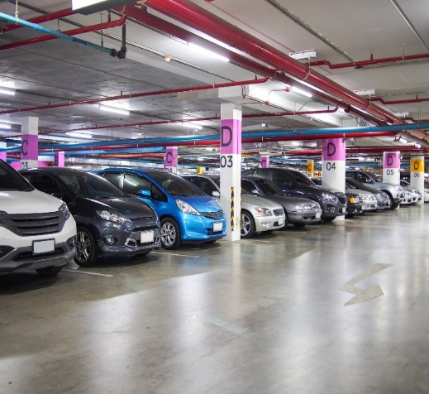
How Does It Work - Parking
Parking expenses:
Participants use their BASIC Card to pay for parking at parking facilities
You can pay for parking personally (out of pocket)
and then submit a claim to BASIC for reimbursement to their MyCash Account.
  Participants can submit claims through the
  BASIC Benefits App with a photo of a receipt

Slide 52

THANK YOU
Additional CDA Participant Resources
https://www.basiconline.com/hq/employee/basic_cda/

Slide 53

Contact BASIC FSA
BASIC wants to help you with your benefits!
Please contact BASIC at the phone number below or your HR Department with any questions about your FSA benefit. You can also submit a Support Request via CDA online or in the BASIC benefits app.
  Phone: (800) 372-3539

